Slide 1
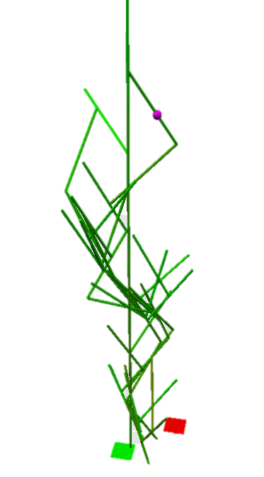
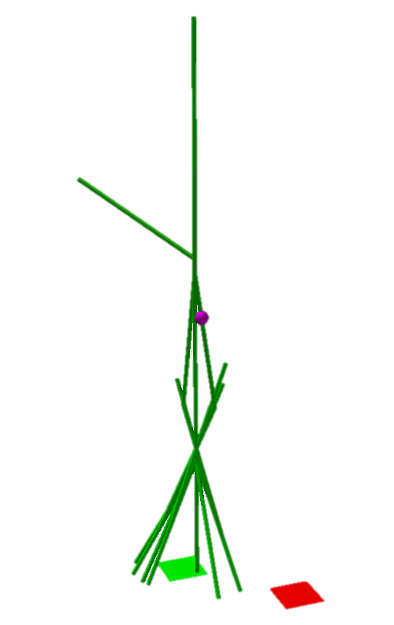
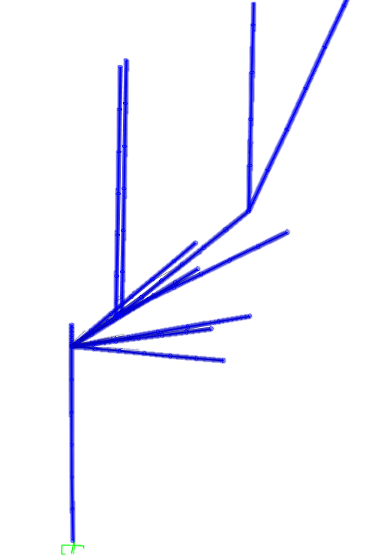
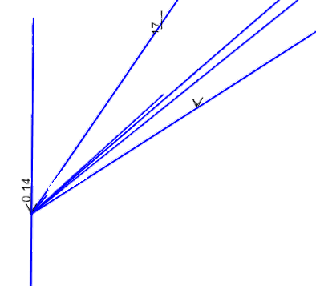
Decentralized, Collective Robotic Construction
Simulation of vertical, self-supporting structures

Slide 2
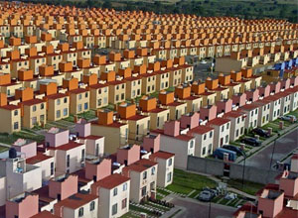
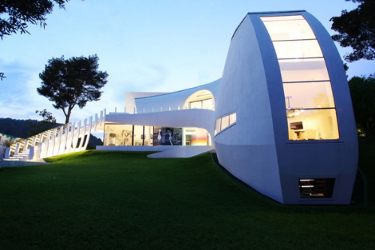
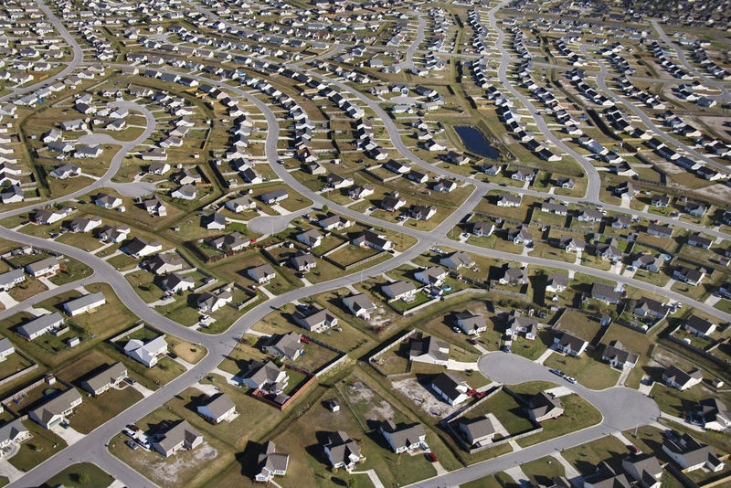
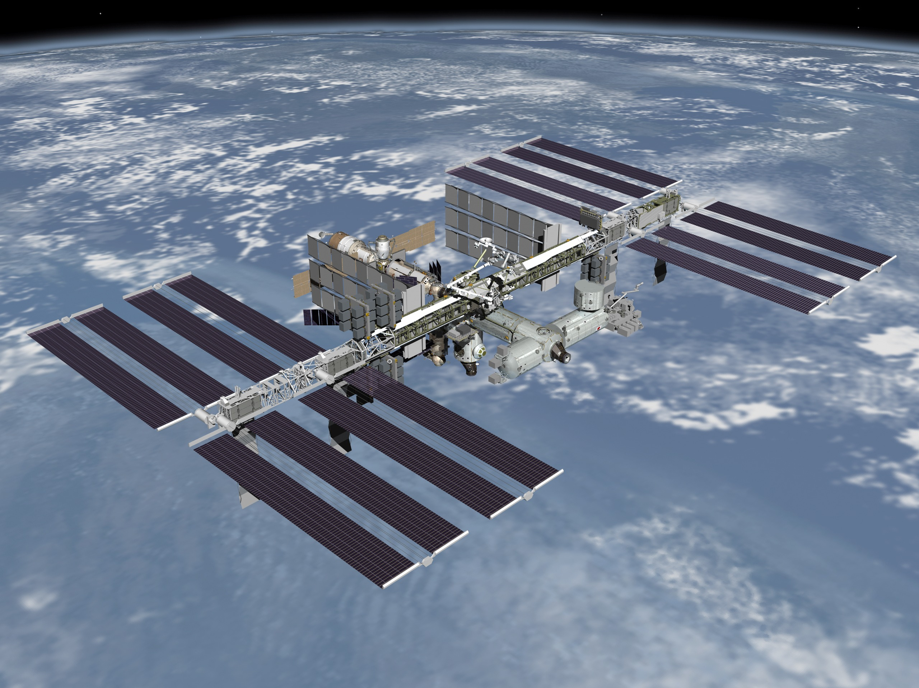
Modern construction revolution
One Design, Million Homes
One project, million dollar design
Ctrl-C, Ctrl-V, -V, -V, -V
http://blog.redfin.com/local/wp-content/uploads/sites/2/2008/06/suburbs.jpg
http://picturesplace.files.wordpress.com/2010/04/wpid-outrageous-modern-homes-casa-son-vida-1-the-luxury-spanish-villa-by-marcel-wanders-3.jpg
http://www.newclearvision.com/wp-content/uploads/2011/05/suburbs.jpg
http://blogs.voanews.com/science-world/files/2012/11/160554main_jsc2006e43519_high.jpg

Slide 3
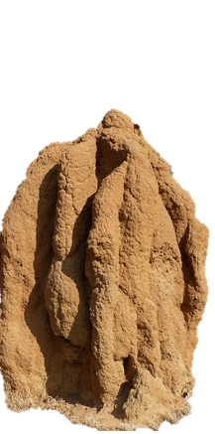
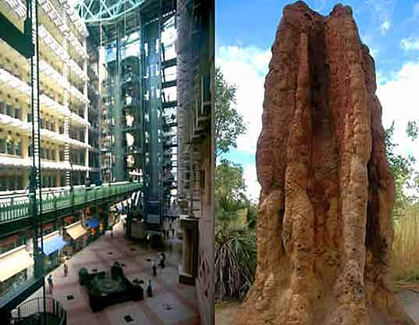
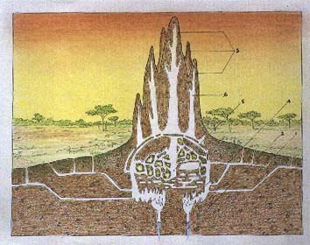
Nature-inspired Solution
Adaptive
Reactive
Little design
Set of goals
Structurally stable
http://assets.inhabitat.com/files/eastgatew_mound1.jpg
http://www.ldc.upenn.edu/myl/abm/termite1.jpg
http://people.seas.harvard.edu/~jkwerfel/

Slide 4
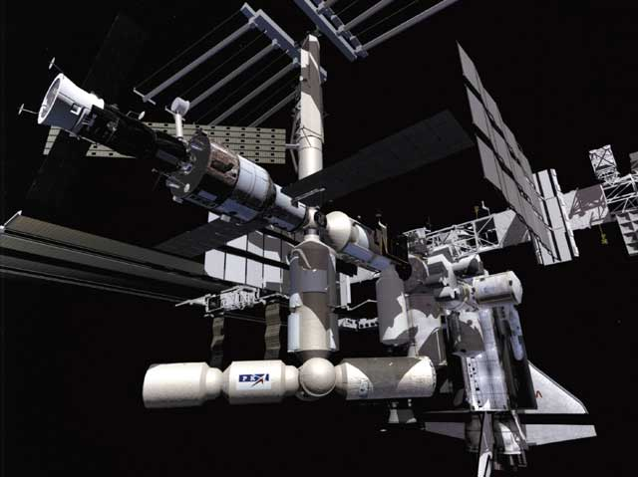
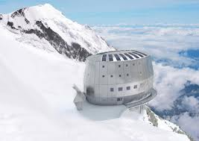
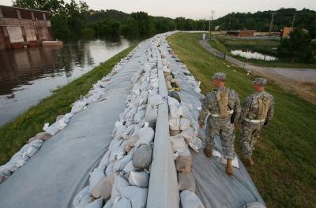
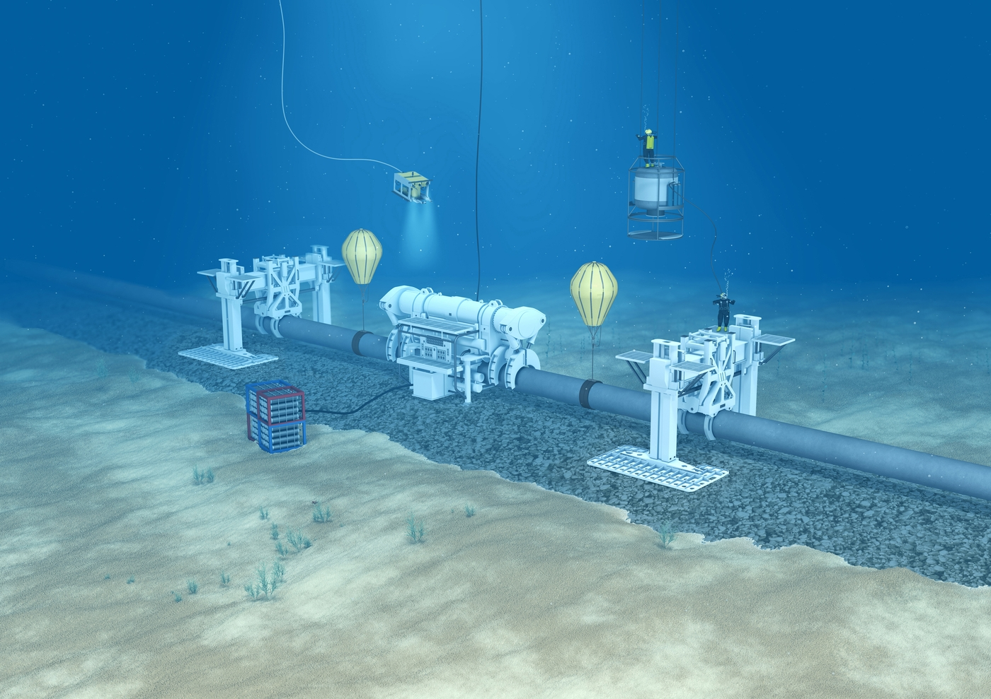
Why?

Slide 5
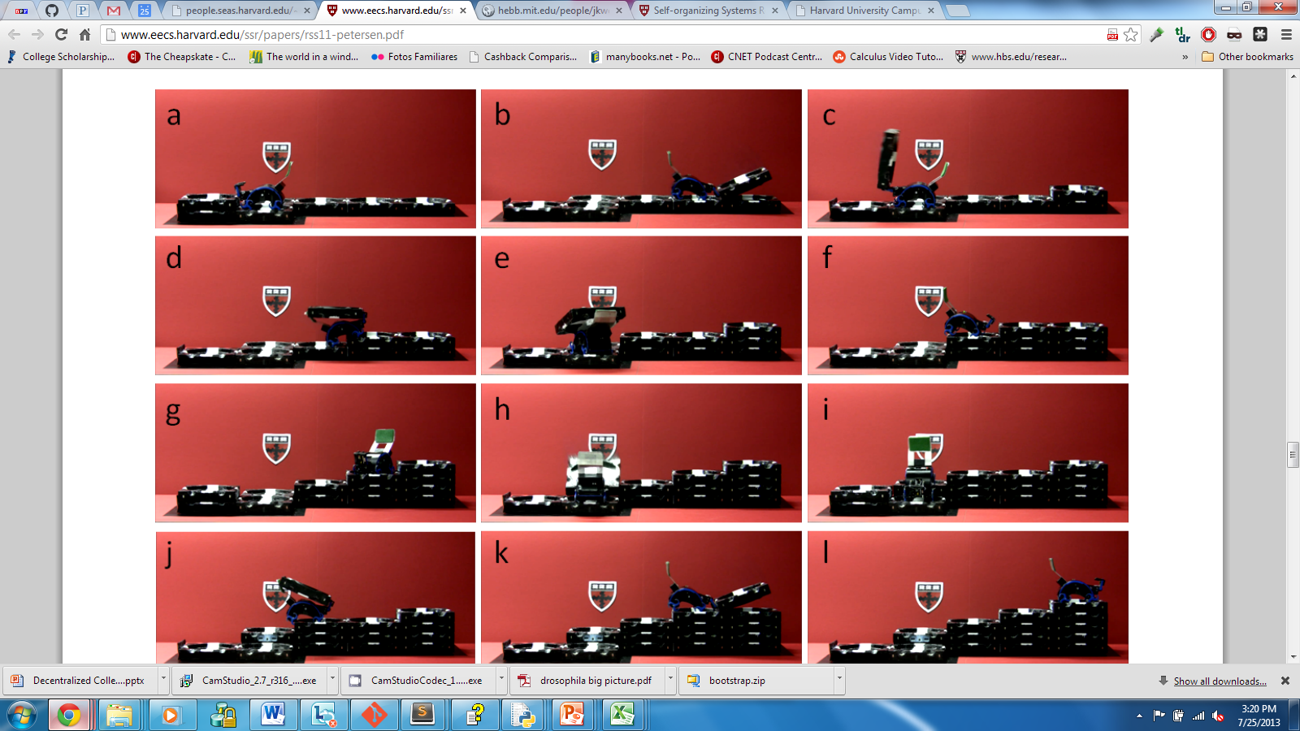
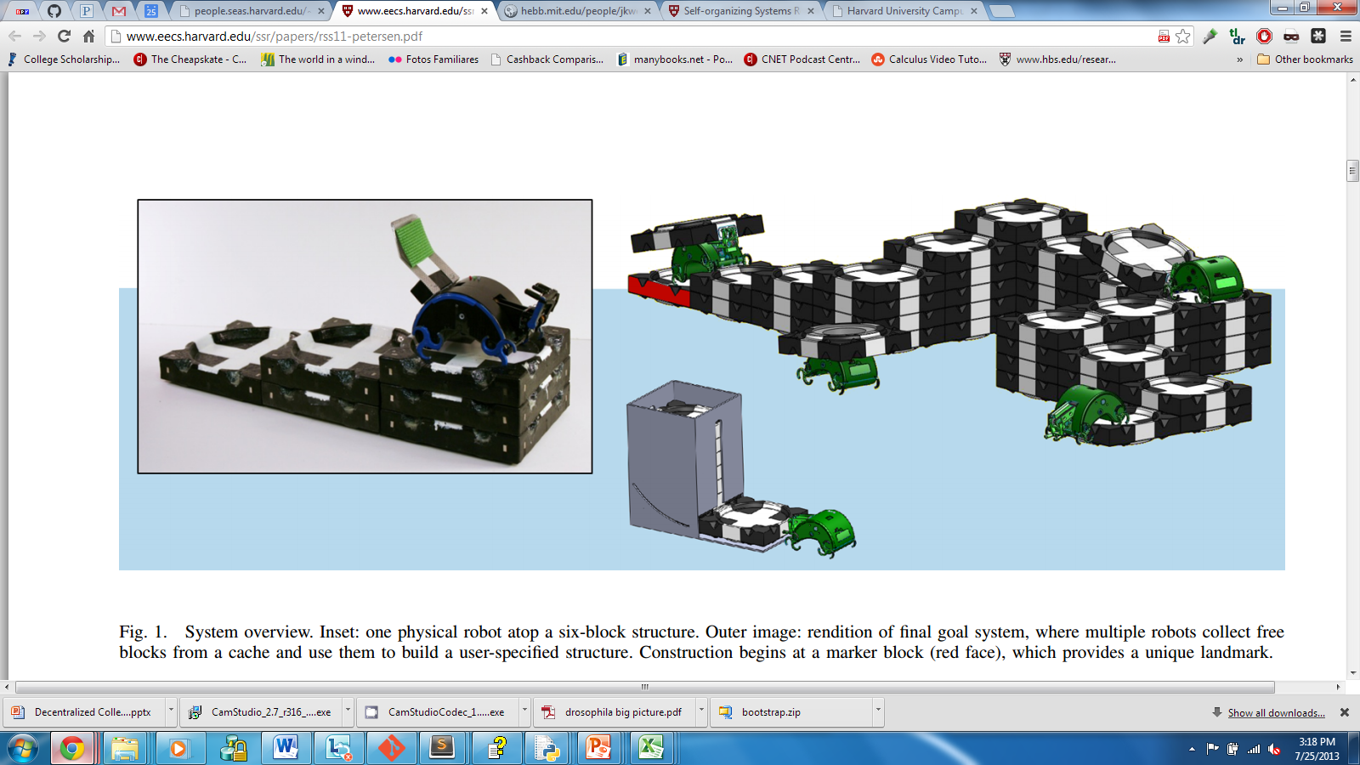
Collective Construction
TERMES Project
Structures 15x the size of any individual worker
Replaceable Robots
Adaptive Construction
Stigmergy
Communication doesn’t scale
Environmental clues
Active
Passive

Slide 6
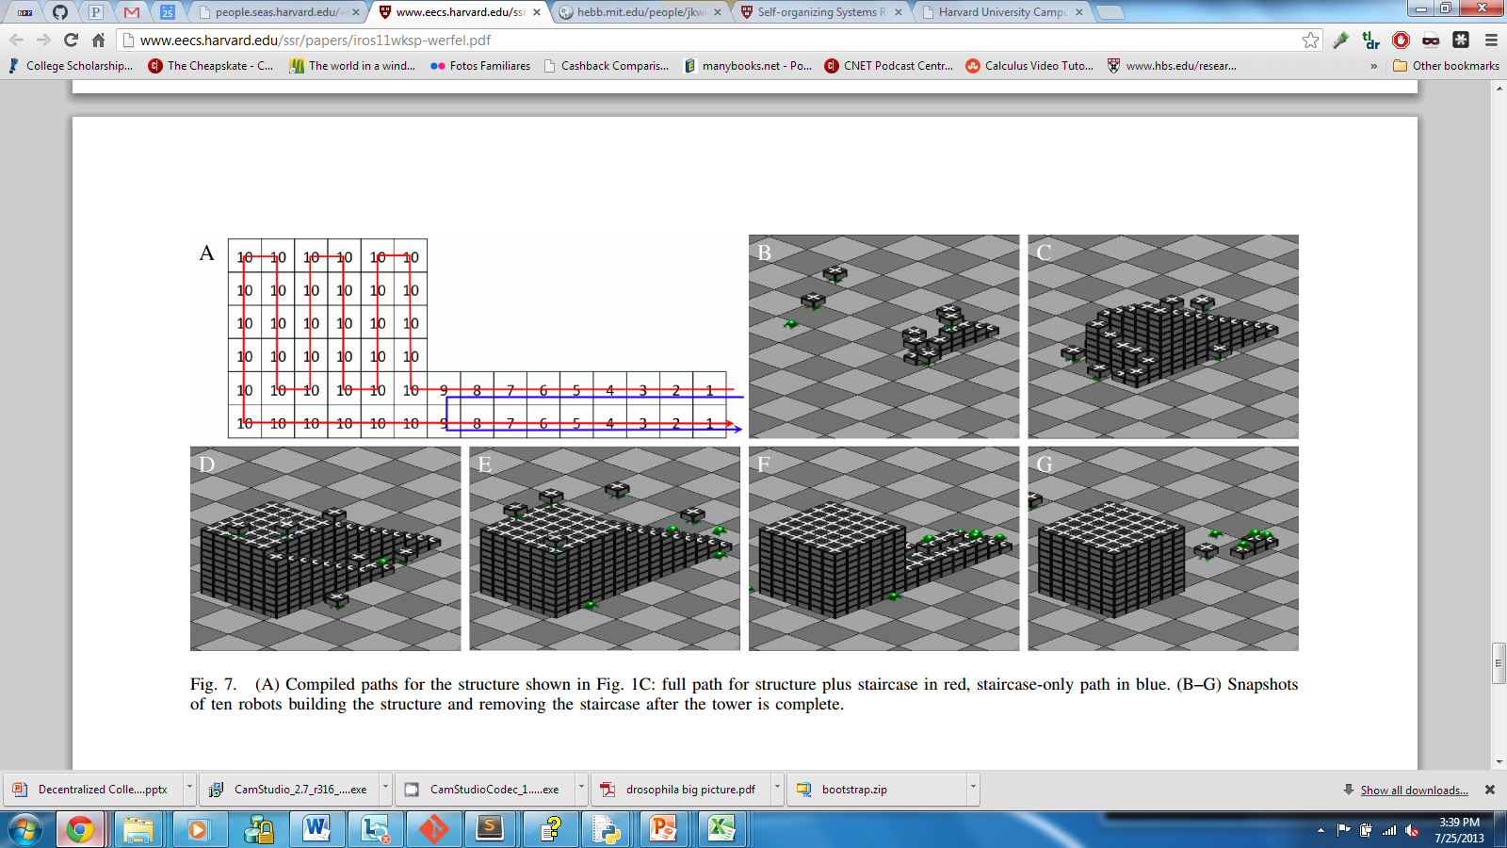
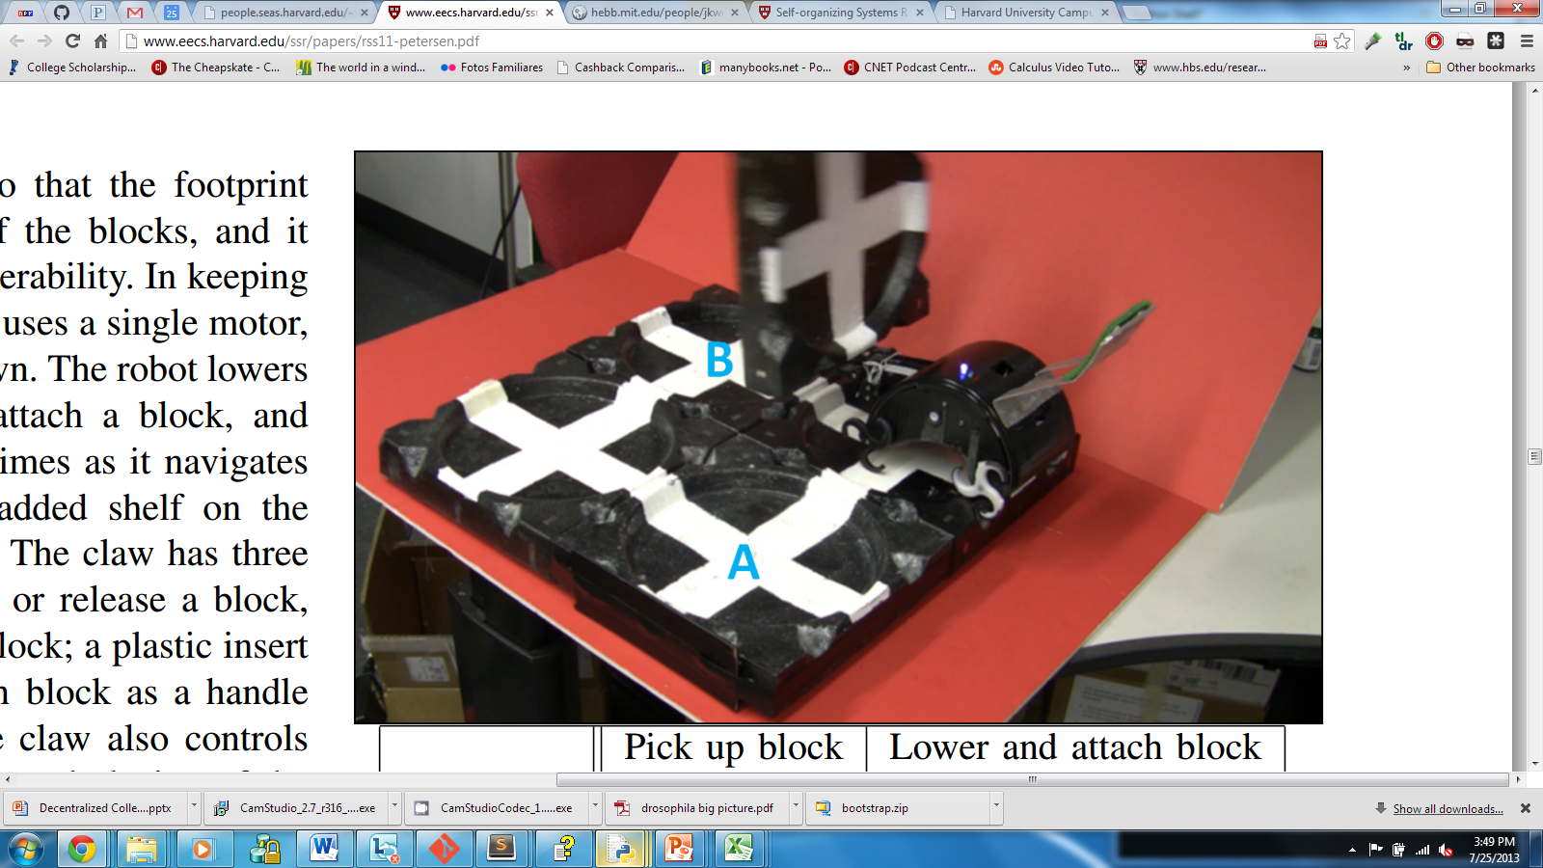
Decentralized Construction
Compiler – Designed Structures
Building material – physically sturdy
Designed to be stable at all times

Slide 7
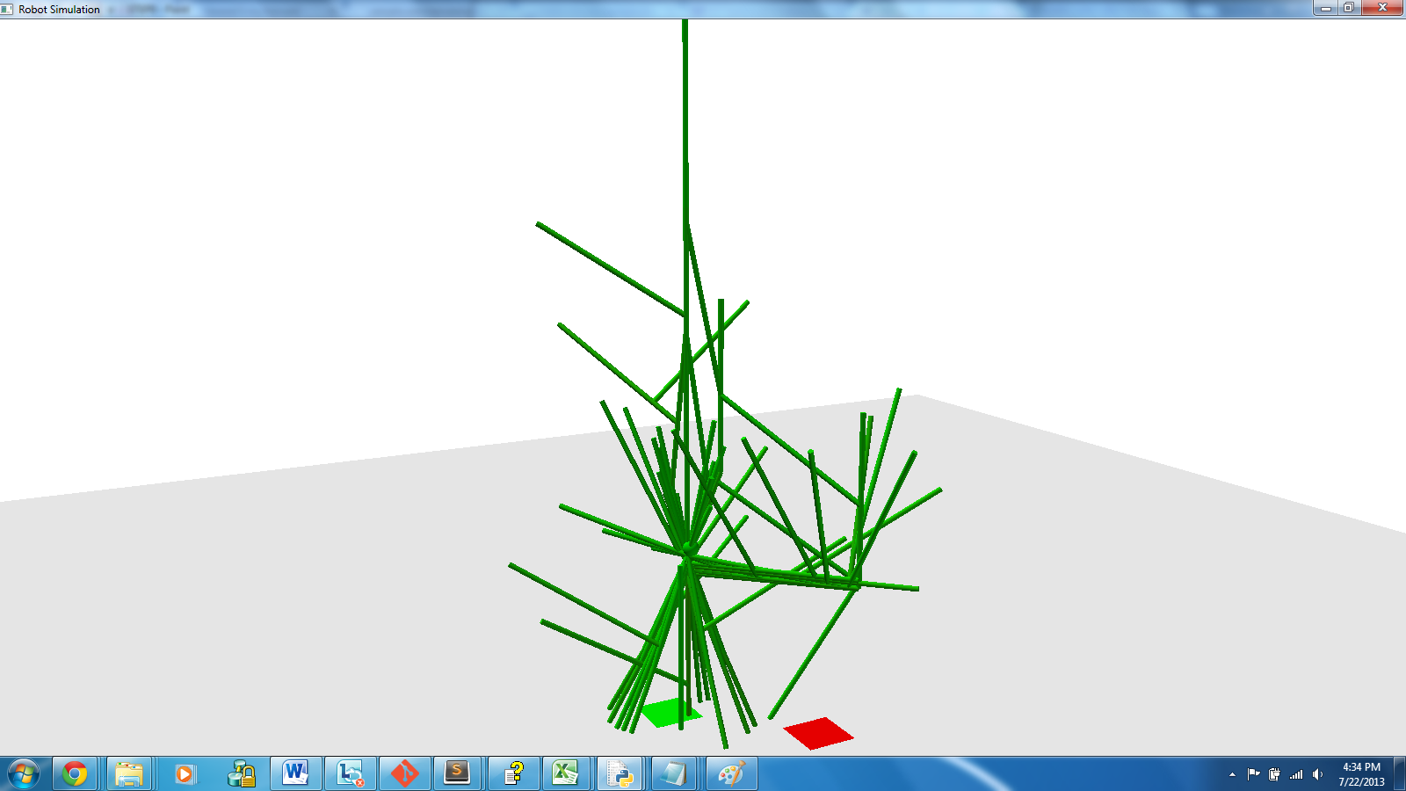

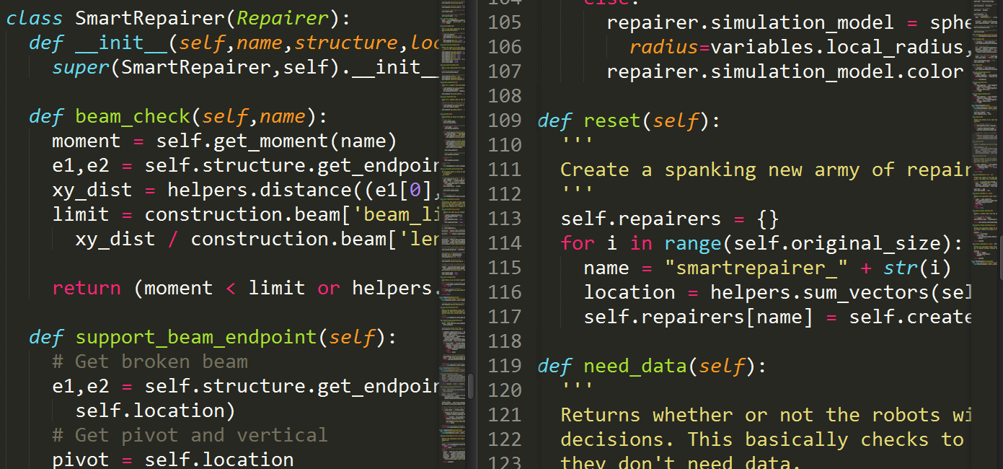
Project overview
Software suite
Materials, inputs
Swarm’s algorithm
Python 3.2.2
VPython 5.74 for Visualization
PyWin32 for Windows Interface
Xlsxwriter library
Structural Analysis Program (SAP) 2000 v15
SAP Open Application Programming Interface (OAPI)
Moment of Force
Runtime Execution (per timestep)
Decision Step
Action Step
Construct mode, support mode, repair mode, ground mode
http://www.csiberkeley.com/files/images/SAP15_770.jpg

Slide 8
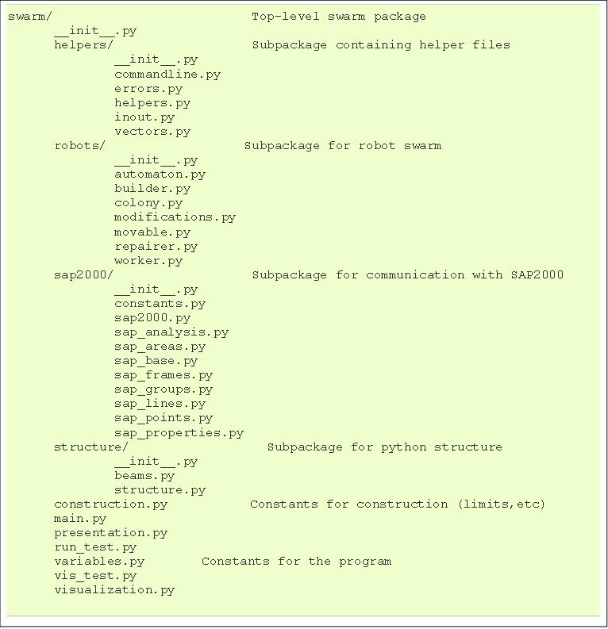
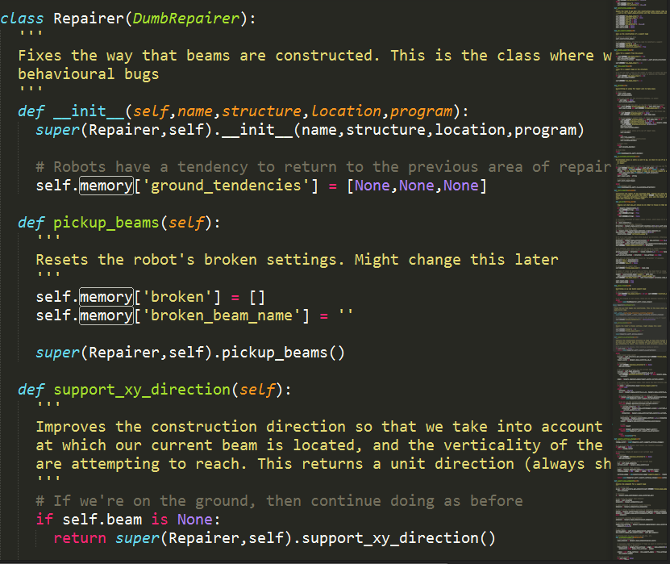
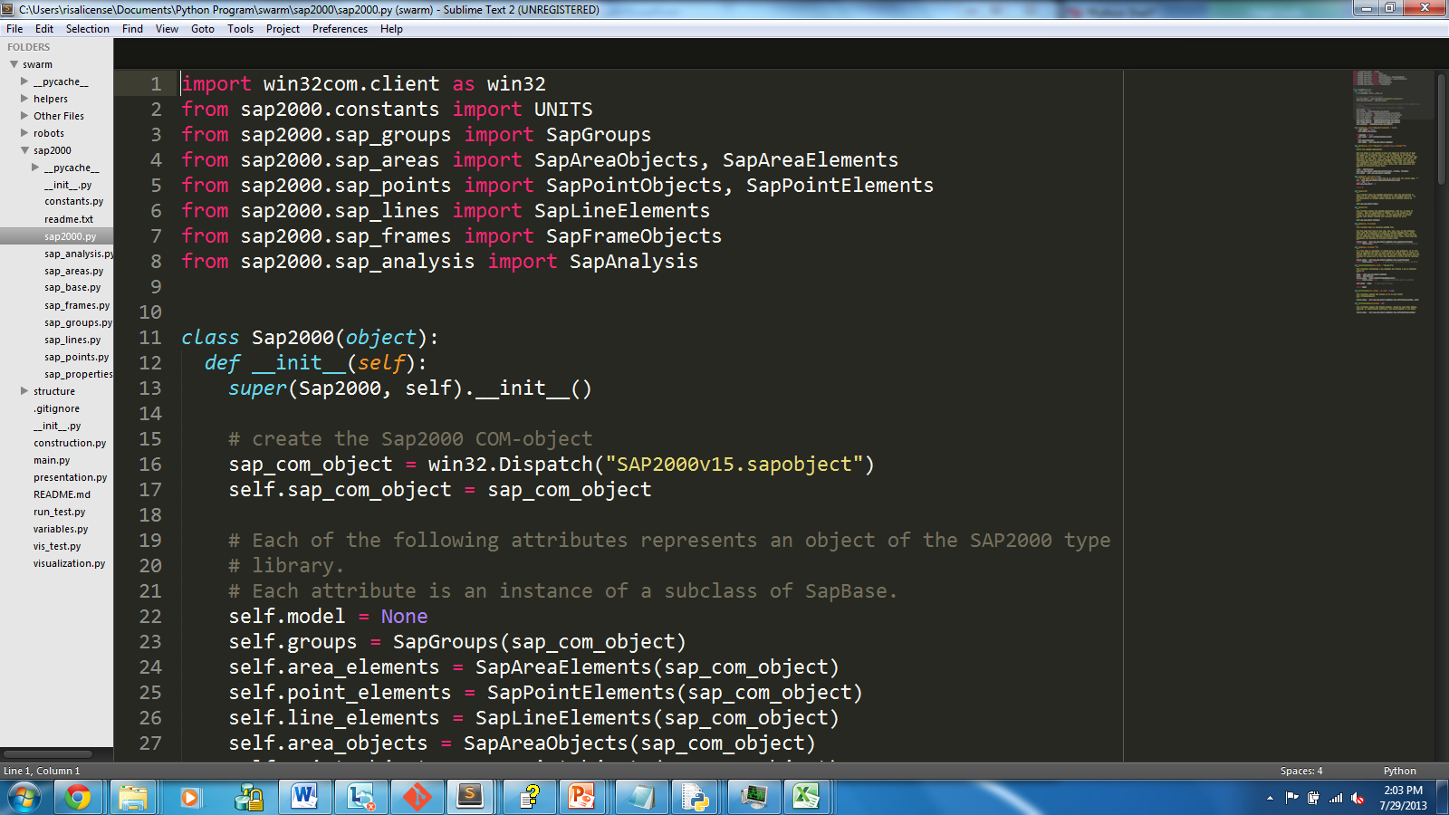
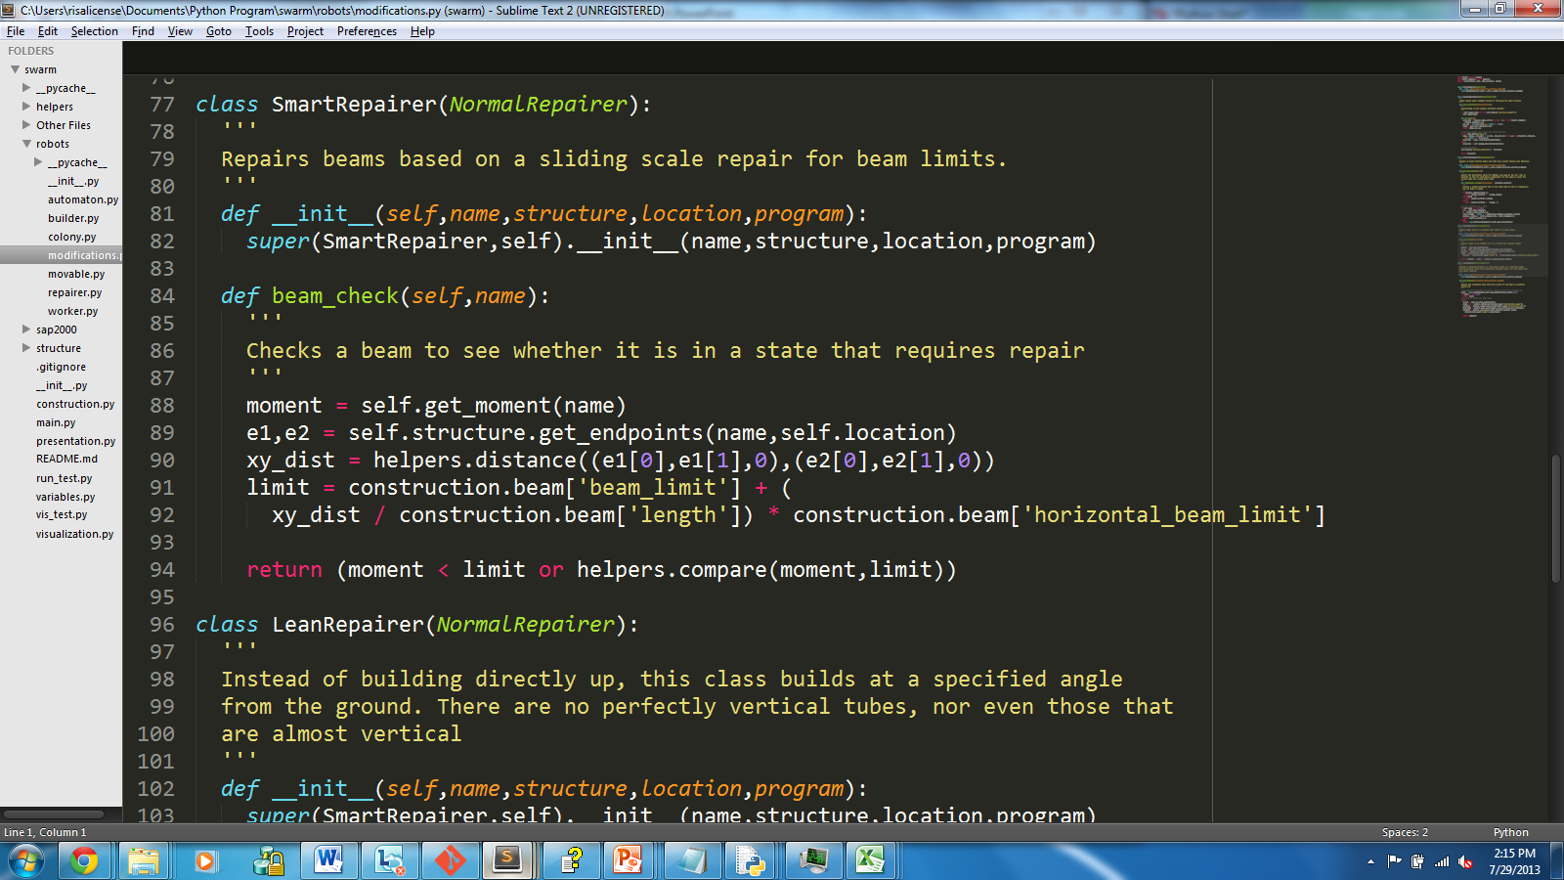
Python Package - Swarm
Python Specific OAPI
Sap2000 package
Swarm Logic
Repairer.py
Base class
Modifications.py
Python-ic Structure Storage
Main code
Execution, visualization, constants, presentation

Slide 9
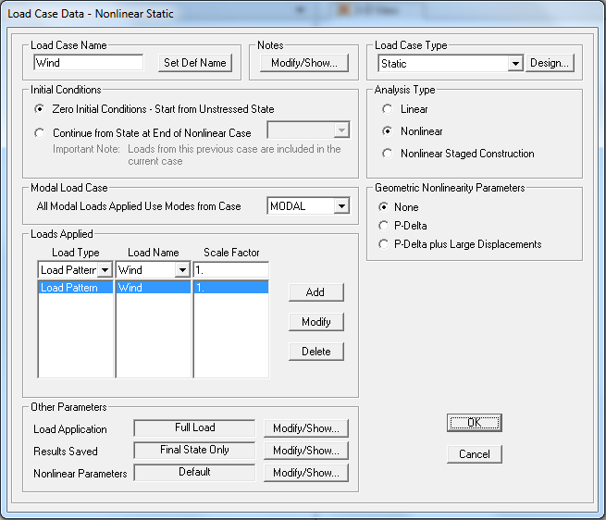
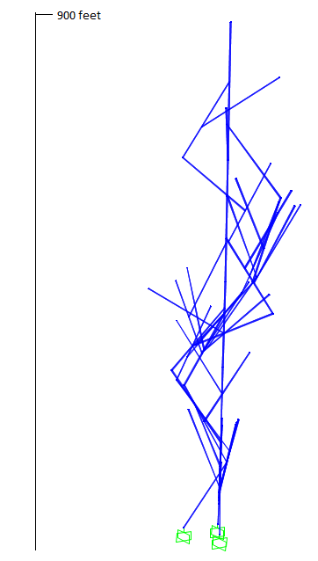
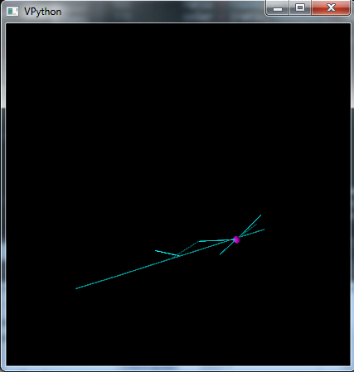
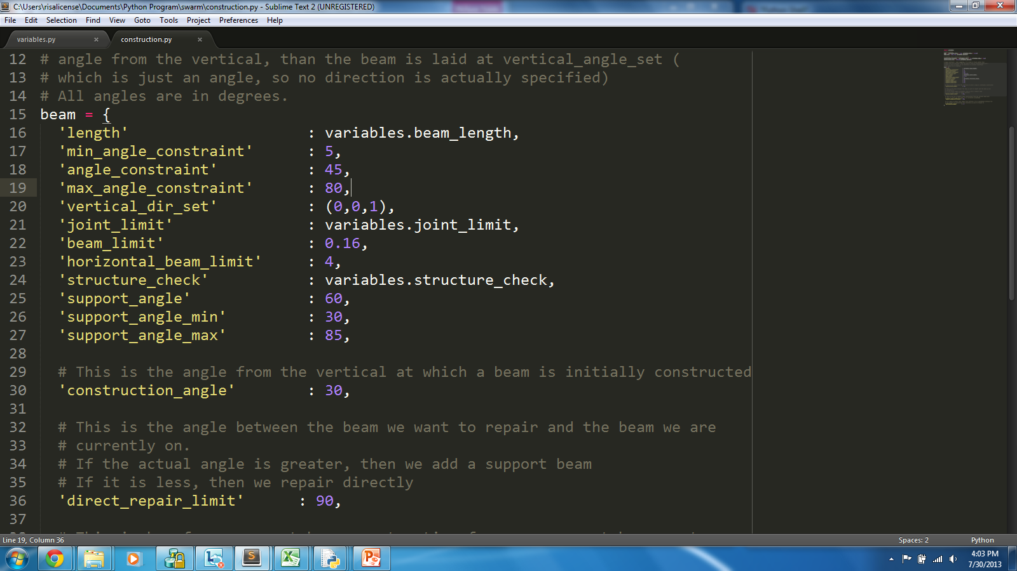
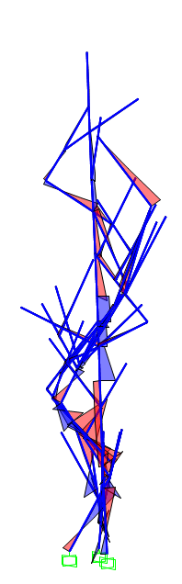
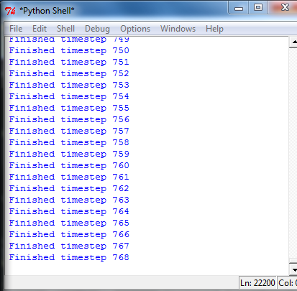
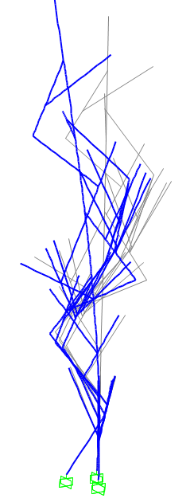
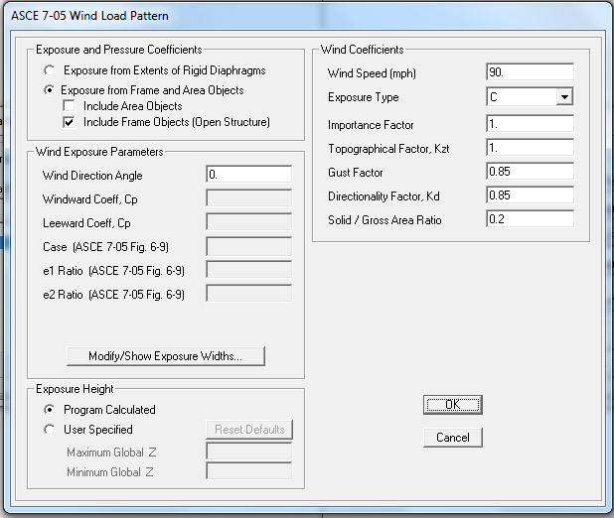
Methods: Virtual Tower COnstruction Simulation
Explore
Set Rules – repairer.py
Execute simulation
Analyze
Failed Model Analysis
Modify
How, why?
Previous Model Results
modifications.py – new rules, logic changes
Model template file
Visualization
Structure Analysis
variables.py, construction.py – constant changes
Set wind
height
moments
deflection

Slide 10
Results and Discussion

Slide 11
Conclusions

Slide 12
Acknowledgements

